Slide 1
Lesson 4: Storage Classes
By: Ryan Alterman
Revised: 8-27-17

Slide 2
What are Storage Classes?
Help define the scope and lifetime of variables and functions
They are defined before the type that they modify
There are five types:
Auto
Register
Static
Extern
Mutable

Slide 3
Auto Storage Class
Default storage class for local variables
You do not have to specify the storage type as auto

Slide 4
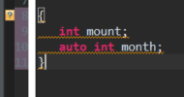
Code showing the declaration of local variables with the auto storage class

Slide 5
Register Storage Class
Changes the storage location
Instead of RAM, it stores as a register
This changes the properties of the variable quite a bit
It now has a maximum size equal to the register size
It can also not have the & operator applied to it
Should only be used to make a variable quick for accessing
Also, depending on the hardware, it MAY be stored as a register
It is not guaranteed

Slide 6

Code showing the use of the register storage class

Slide 7
Static Storage Class
It can be used on local and global variables to have different effects
Local Variables
It will change its scope
It will keep the variable instead of destroying it once it is out of scope
Allows for variables to maintain values between function calls
Global Variables
Keeps the scope to the file i which it was created

Slide 8
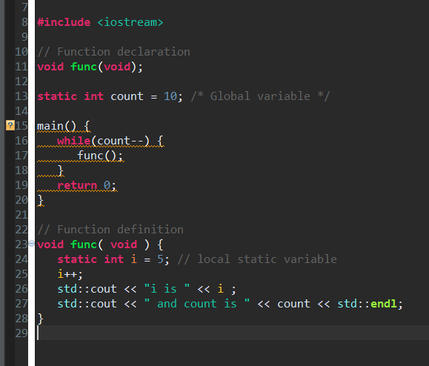
Code showing the use of the static storage class

Slide 9
Extern Storage Class
Can only be applied to global variables and functions
It modifies the scope of the variable
It acts as a reference for other files
Using the extern class prevents initialization of the variable
It just points to the global variable
All it is for is to declare a variable in another file

Slide 10
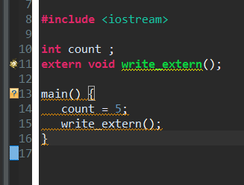
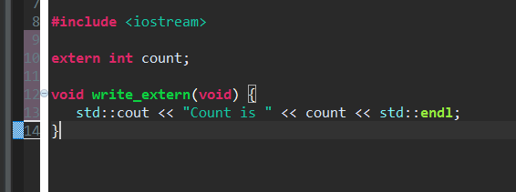
It is declared here
It is used here in a secondary file
Code showing the declaration and use of the extern storage class

Slide 11
Mutable Storage Class
It is used to modify class objects
It can override the state of an object from being constant
Which in turn also means that it can be modified by const
More in this later when we talk about Class Objects.

Slide 12
Challenge
I want you to make variables, functions and classes, apply storage classes to them and see what happens. But just ignore mutable storage classes for now.

Slide 13
Next: Operators

